Slide 1
Sport & Leisure:
Newtown, 1850-1914
Newtown TextileMuseum Exhibition 2024

Slide 2
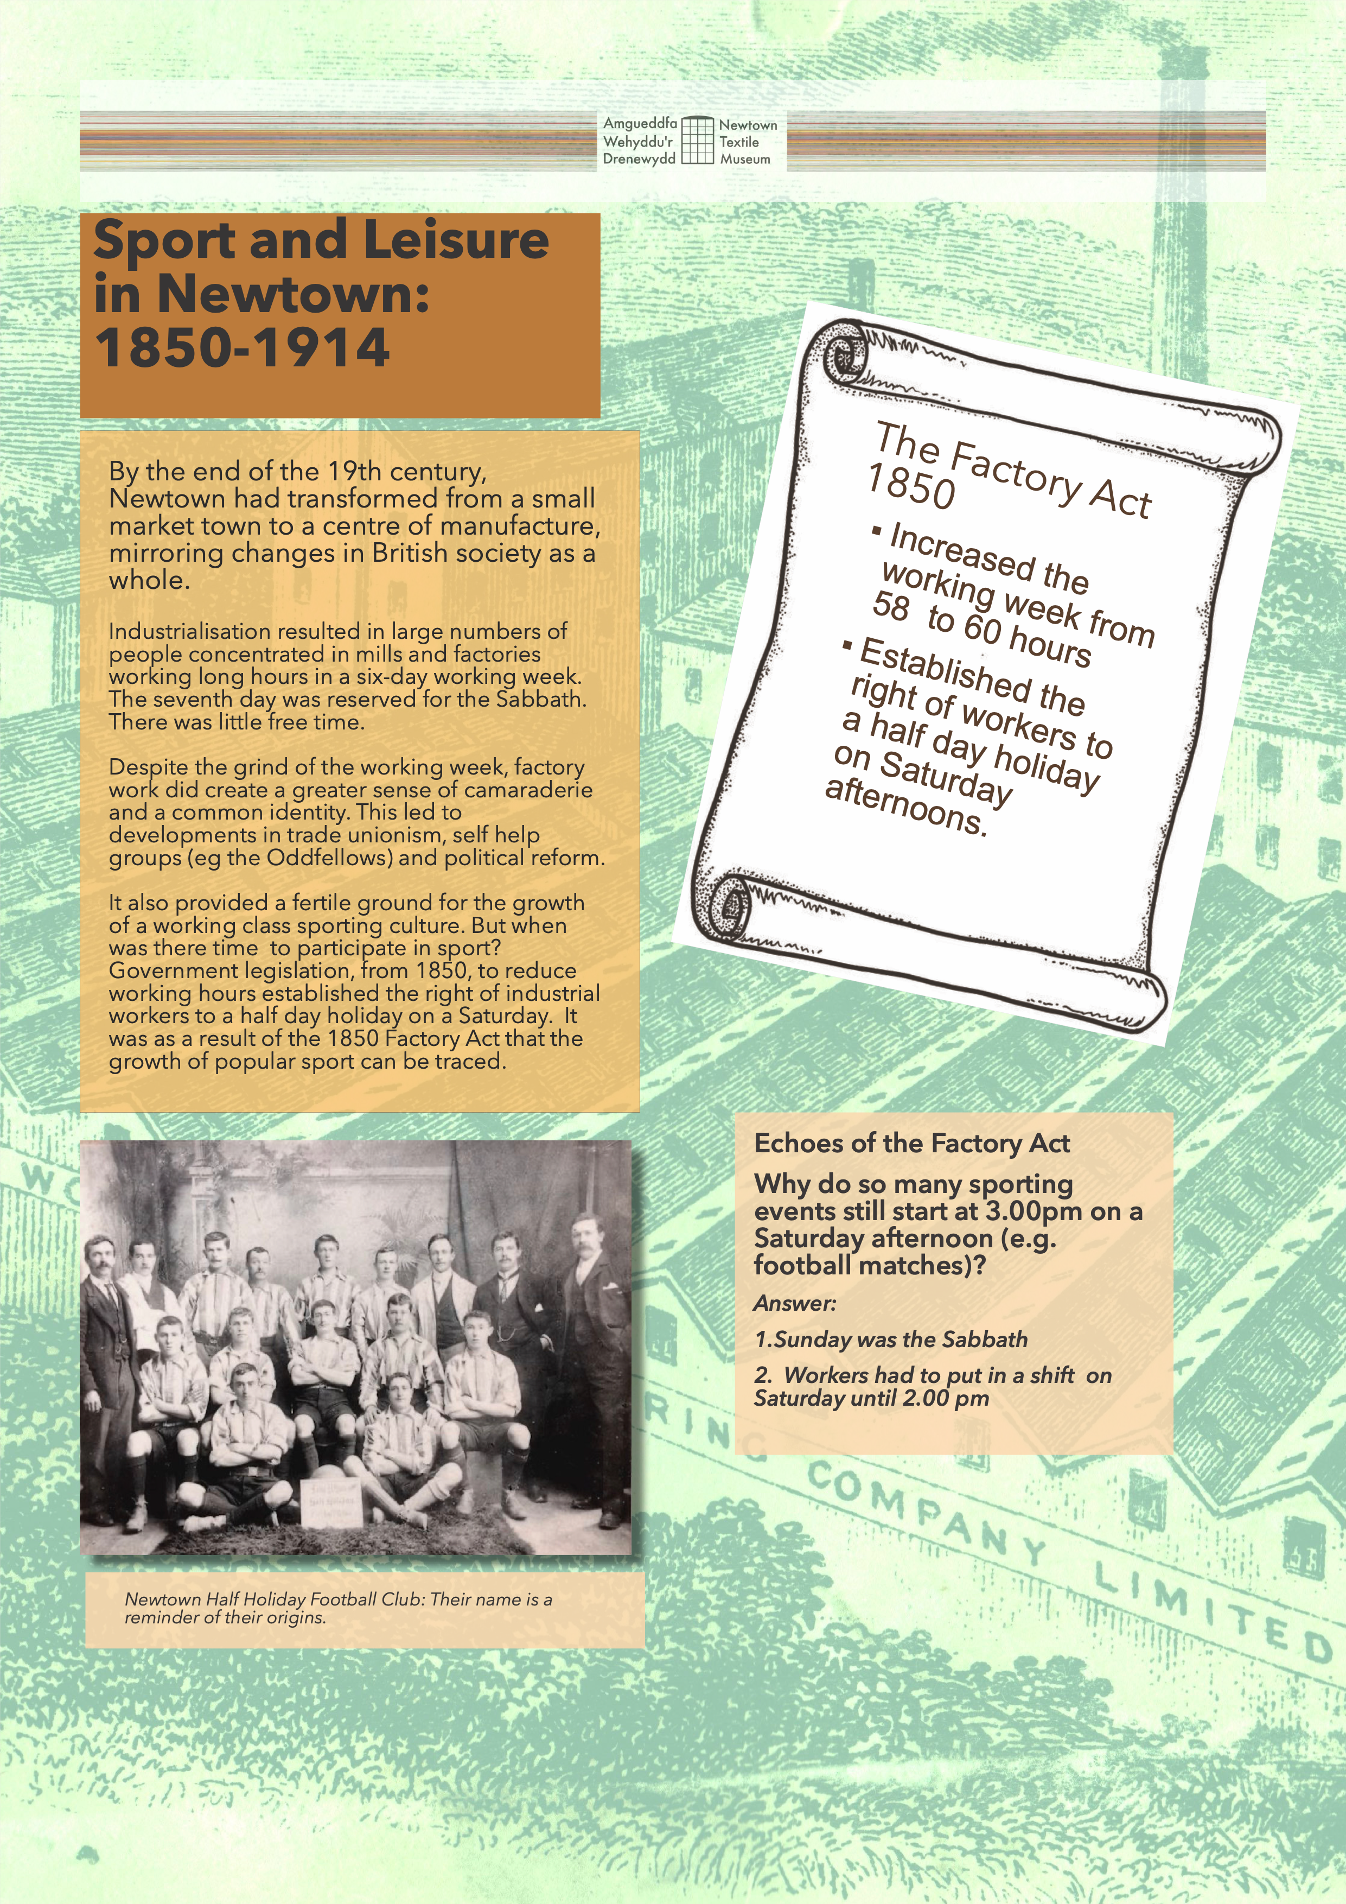

Slide 3
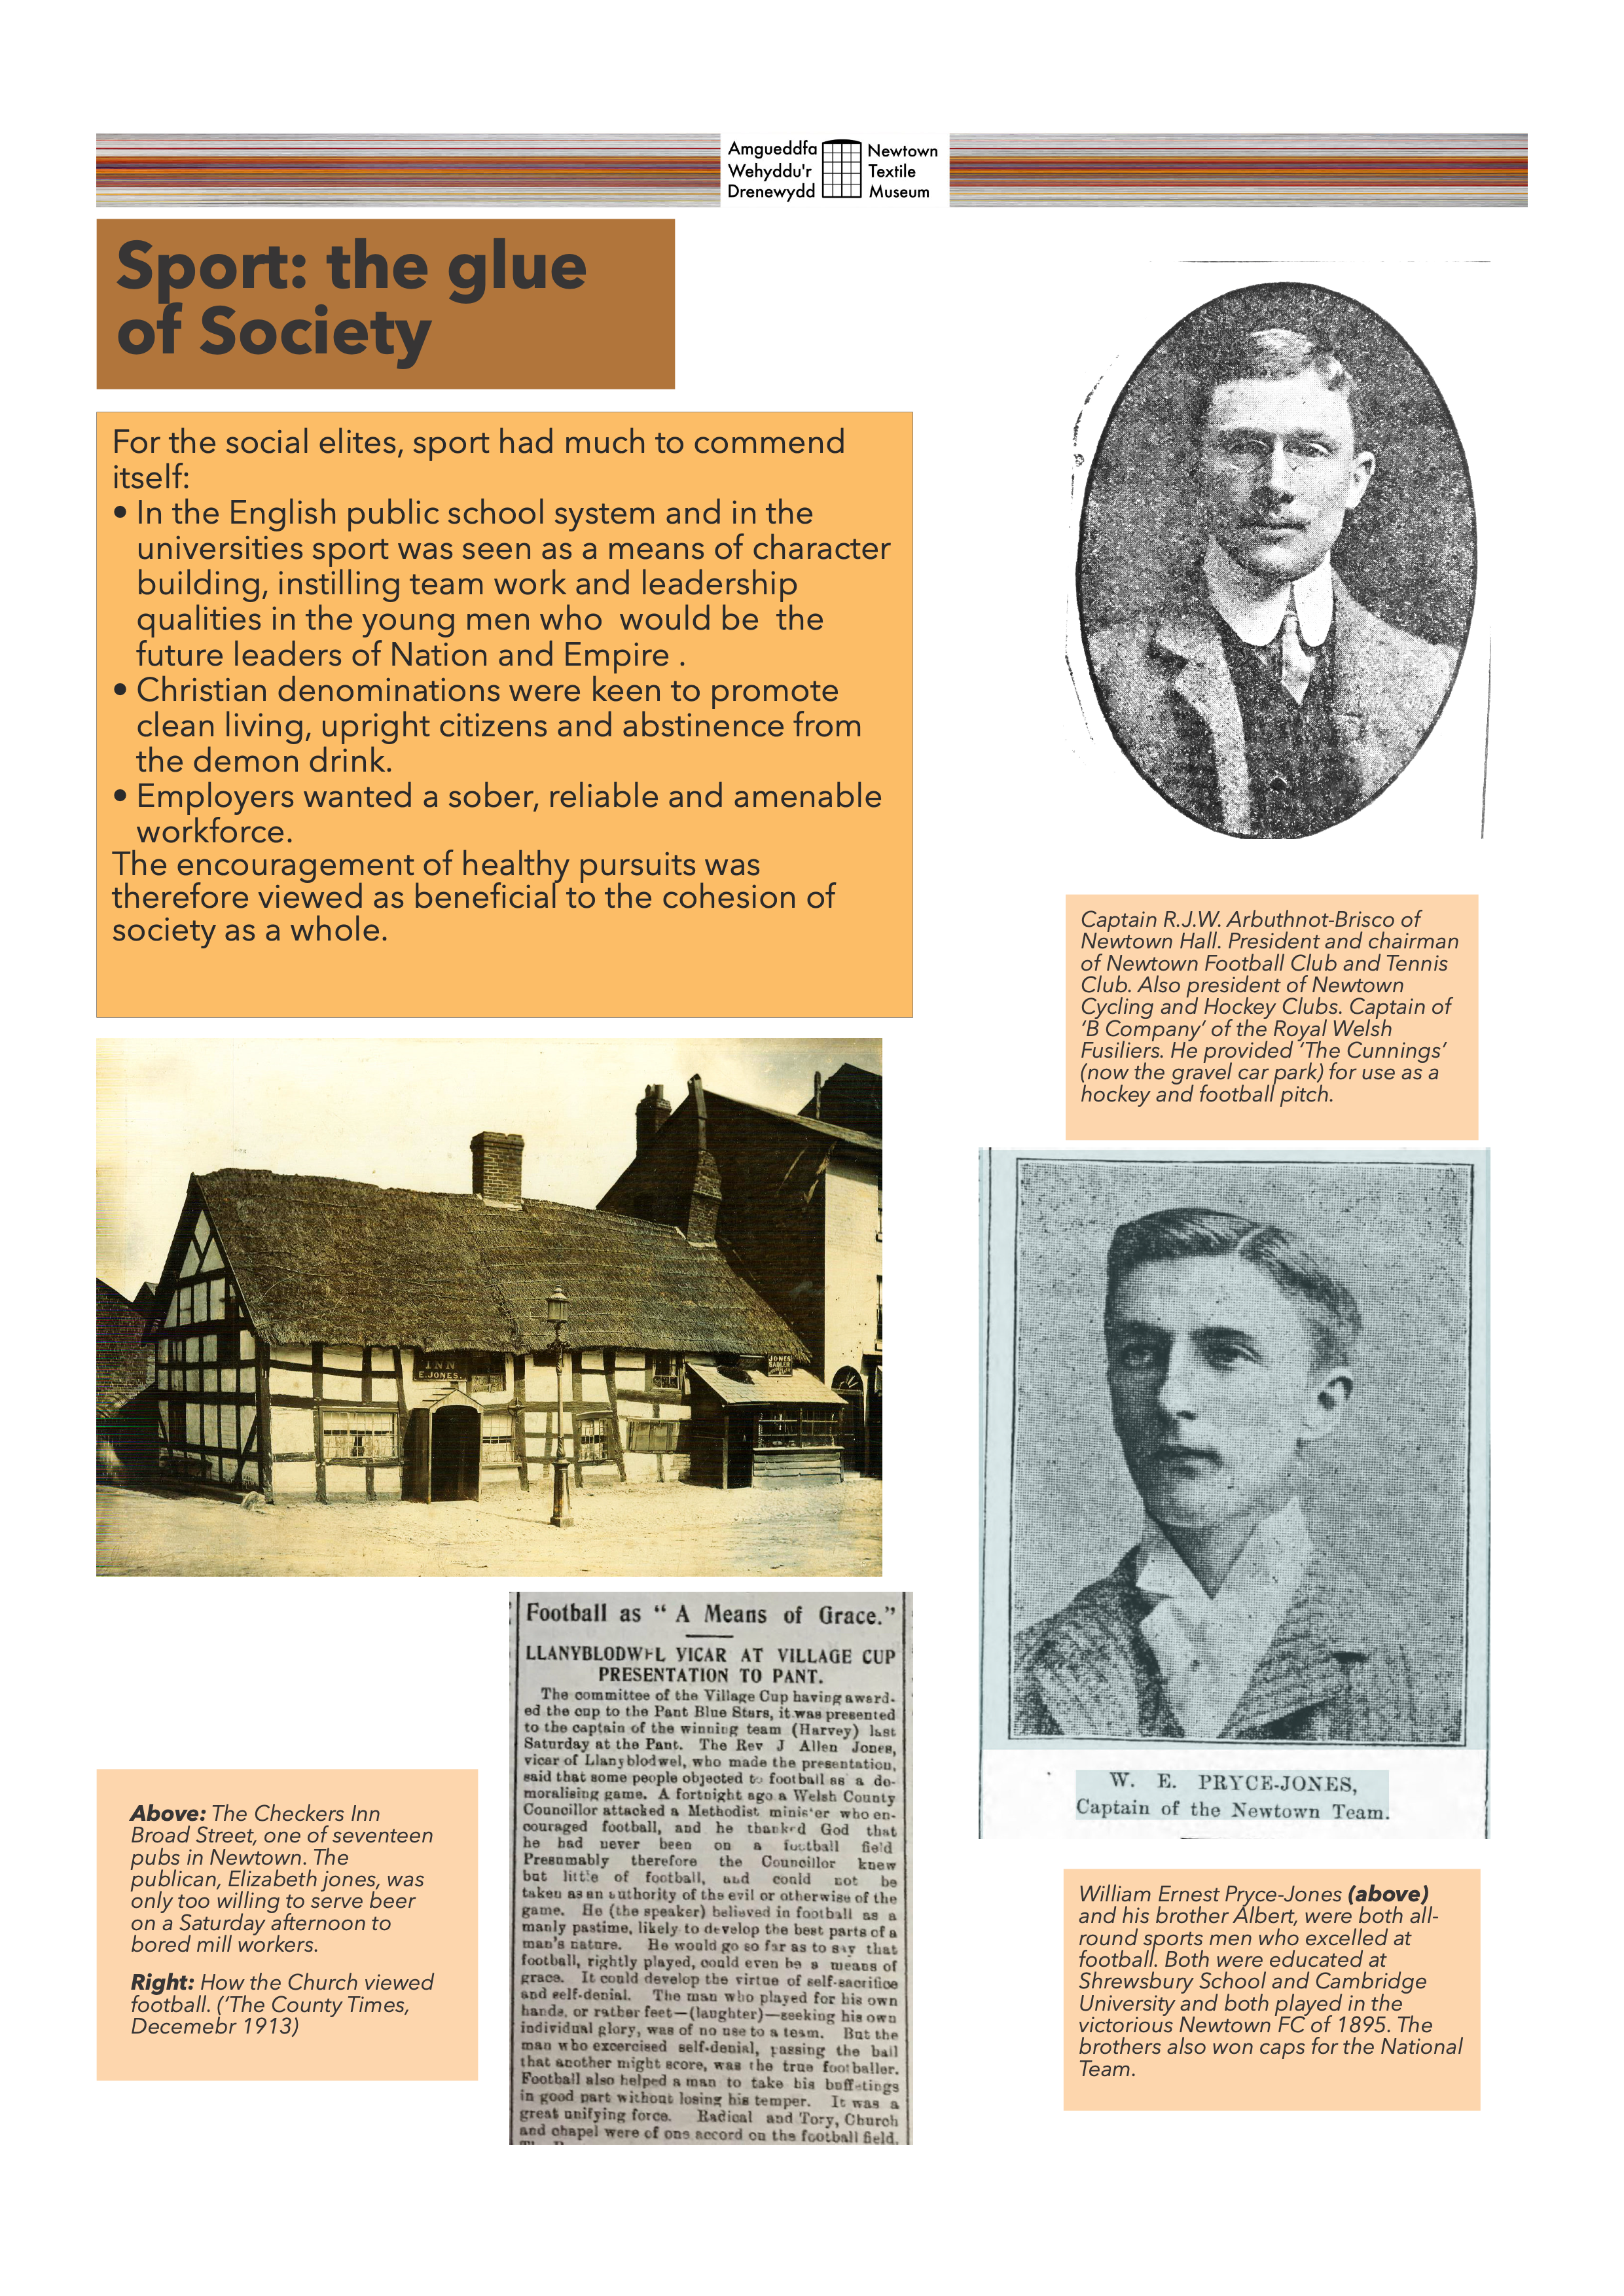

Slide 6
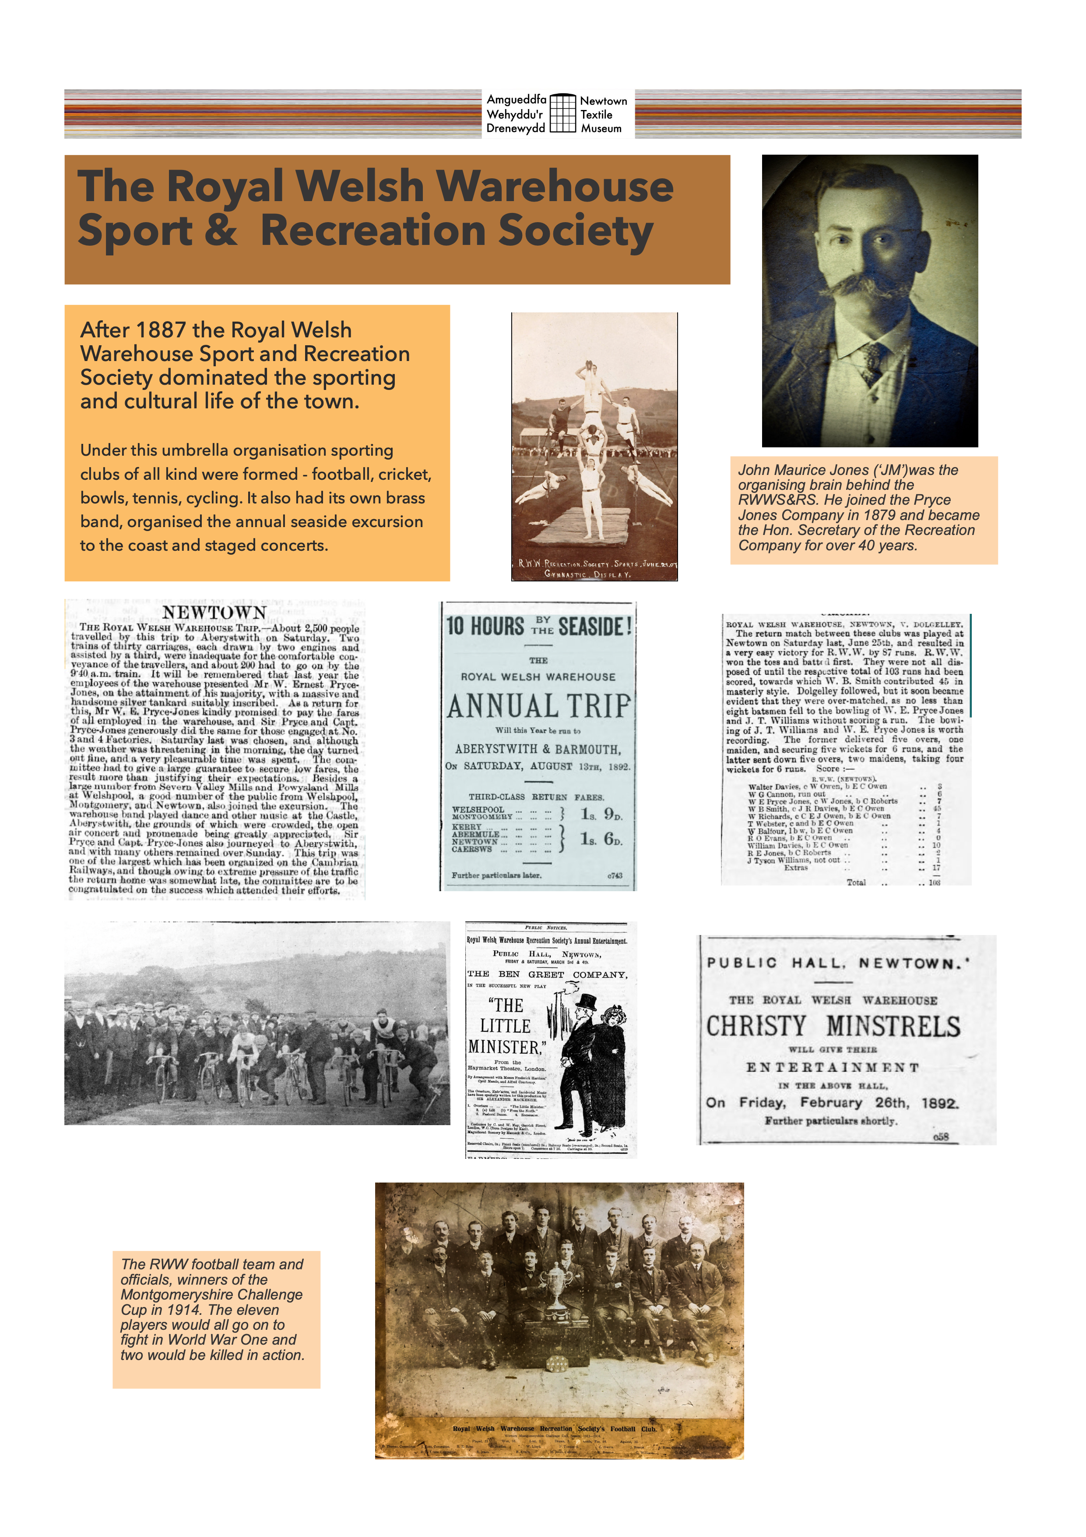

Slide 7
